Slide 1
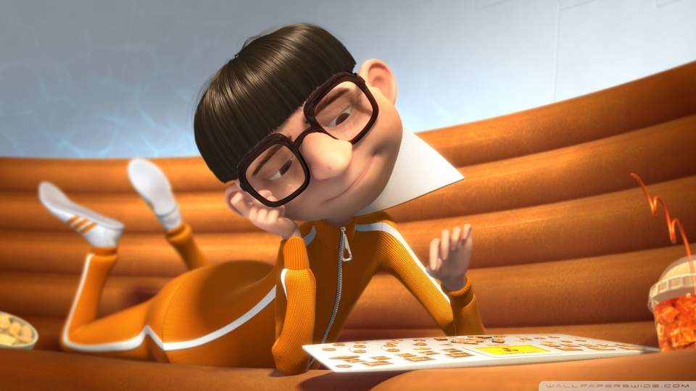
Bell Work This is Vector. Identify the two factors described by a vector in Science

Slide 2
Bell Work 31-4
Differentiate between a meteor, meteoroid, and a meteorite.

Slide 3
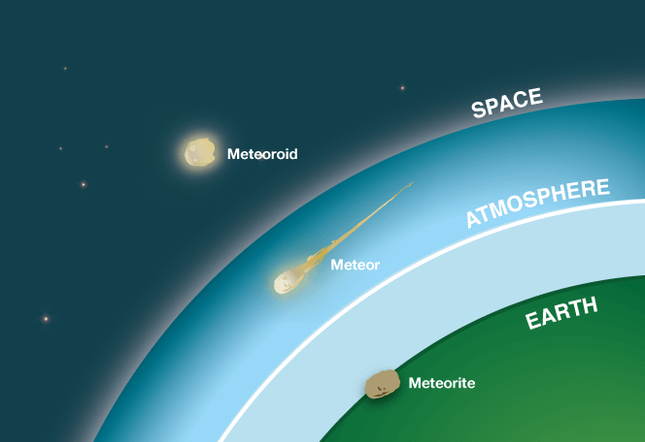

Slide 5
Physical Properties of Matter
Size dependent – property is directly proportional to sample size (ONLY 3)
Mass
Volume
Weight
Size-independent – property is constant, regardless of sample size (all others)
Boiling/melting point
Density
Conductivity (thermal and electrical)
Ductility (pulled into wires)
Malleable (banged into sheets)

Slide 6
Chemical Properties
Can only be observed by changing the substance into something new
Flammability
Ability to rust
Ability to tarnish
Ability to decompose/rot

Slide 7
Density
You take the mass… divide it by the volume, at last!!!! d (g/mL) = m(g) / v(mL)
Increasing the mass only will increase the density (directly proportional)
Adding books to your back pack
Increasing the volume will decrease the density (indirectly proportional)
Removing air from a “space bag”

Slide 8
Atoms
Atoms are the smallest unit of matter
They are made up of:
Nucleus (protons⁺ and neutrons⁰)
Electrons⁻
The number of protons determine the identity (which element it is)
Use the atomic number on periodic table
An element can have different numbers of neutrons
Different forms are called isotopes
An element can have different numbers of electrons
More electrons than protons gives the atom a negative charge (negative ion)
Fewer electrons than protons gives the atom a positive charge (positive ion)

Slide 9
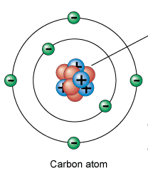
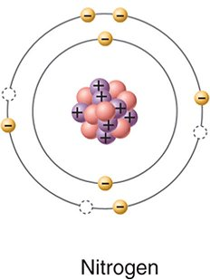
Atoms and Elements
Label the parts of the atoms above. What is the difference between a Carbon atom and a Nitrogen atom?
SC.8.P.8.7

Slide 10
Pure Substances
Pure substances include both elements and compounds
Elements – listed on the periodic table, only one type of atom
Elements combine chemically to make up compounds, which make up all living and non-living things
Compounds – more than one element chemically bonded together in fixed ratios, has a chemical formula
CO₂ H₂O NaCl CO
Salt, sugar, glucose,

Slide 11
Mixtures
A mixture is a combination of elements, compounds, or elements and compounds that are not chemically bonded
Heterogeneous – can see differences
Homogeneous – can’t see differences
Solution – a mixture in which one substance (solute) is dissolved into another substance (solvent)
Most frequently solids and gases are dissolved into liquids, can be any state of matter

Slide 12
States of Matter
Solids – particles vibrate in place, keep shape of their container
Liquids – particles slide past each other, keep shape of container if container is upright
Gases – particles move quickly, keep shape of container only if container is sealed.

Slide 13
Motion of Particles
Solids, Liquids, and Gases
States of Matter
Think about:
Why do the particles in gases move more freely than those in solids or liquids?
SC.8.P.8.1
Notes:
Can do one or both. Since the FCAT does not require knowledge of Plasma or Bose-Einstein Condensates, this video and/or simulation gives sufficient information for this benchmark, additional discussion about those states of matter can be done at the teacher’s discretion

Slide 14
Periodic Table
Atomic # (whole #) = number of protons
Atomic mass (decimal) = avg protons + neutrons
Elements are grouped into families (columns) according to similarities in their properties
An element will be most similar to another element in its family (look in the same column!)

Slide 15
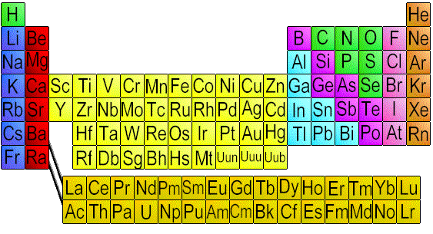
Periodic Table
Which of these elements has properties most similar to Magnesium: Sodium, Calcium, or Manganese? How do you know?
SC.8.P.8.6

Slide 16
Acids and Bases
Acid = pH less than 7, lower the # stronger the acid
Turns blue litmus paper red
Sour taste
Hydrogen donor (HCl, H₂SO₄, HNO₃)
Base = pH greater than 7, higher the number stronger the base
Turns red litmus paper blue
Bitter taste
Hydrogen acceptor (NaOH, LiOH, KOH)
An acid + base → salt + water
Salts – a metal and non-metal bonded together
NaCl, KI, CaCl, LiF

Slide 17
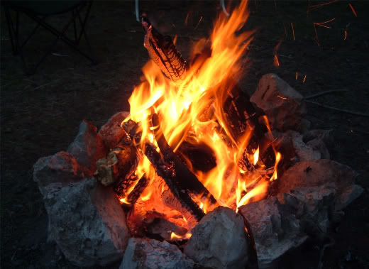
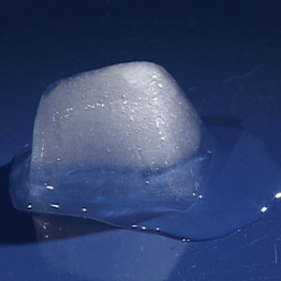
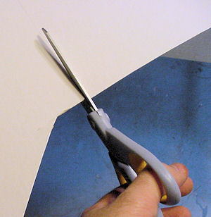
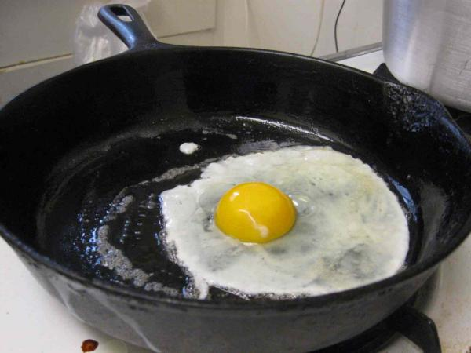
Physical vs Chemical Changes
Which images above are examples of physical changes and which are chemical changes? How do you know?
SC.8.P.9.2

Slide 18
Physical vs. Chemical Changes
Physical Changes – only the form/shape changes
Change in state of matter (melting, freezing, boiling, etc)
Breaking/cutting into smaller pieces
Dissolving one substance into another (making a solution)
Chemical Changes – changes composition
Signs that a chemical reaction has occurred
Bubbling (not from applying heat)
Release of energy (heat, light, or sound)
Change in color/odor
Change is Not reversible

Slide 19
Conservation of Mass
When a chemical or physical change occurs, the total mass of the substance(s) before and after the change MUST BE EQUAL!!!

Slide 20
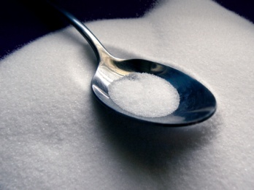
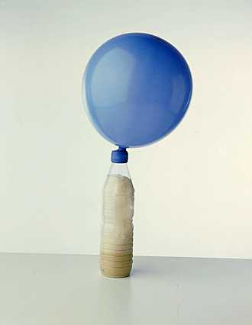
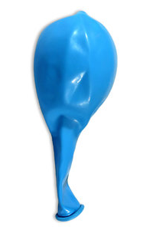
Conservation of Mass
Before reaction
After reaction
500 g total mass
500 g total mass
Explain why the total mass is the same before and after the experiment if a gas was formed and inflated the balloon.
SC.8.P.9.1

Slide 21
Temperature and Chemical Changes
Rate of Reaction
Think about:
What effect did increasing the temperature have on how fast the reaction took place?
SC.8.P.9.3
Notes:
Would just run the beginning simulation, although the rest is useful it tended to get bogged down in the animation.

Slide 22
Weight vs. Mass and volume
Mass is the amount of matter that makes up an object
Weight is the force of gravity acting on an object’s mass
Volume is the amount of space an object takes up

Slide 23
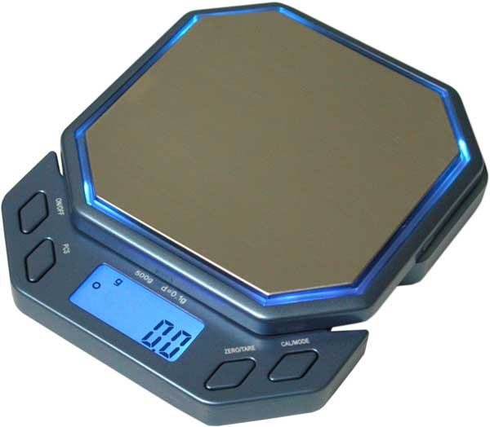
Weight vs Mass
An object is placed on the digital scale and spring scale below and the following readings are observed
9.5g
93.1 N
Which instrument is measuring the object’s mass and which is measuring the object’s weight? Why are the numbers different? Explain your thinking
SC.8.P.8.2

