Slide 1
Life Science
Organization of Organisms

Slide 2
Bell work 26-2 (new sheet)
Create a Punnett Square to determine the probabilities for the offspring
A Heterozygous father who can roll his tongue and a homozygous recessive mother who cannot roll her tongue. What probability will there be that their offspring will not be able to roll their tongues.

Slide 3
Bell work 33-4
What is the name of the process in which plant cells use oxygen to get energy from food?
Take out your Unit 7 packets and a grading pen

Slide 4
Today’s Learning Goals
Review 7th grade Life Science, part 2
Quiz moved to Friday

Slide 5
Theory of Evolution
Evolution refers to the process in which populations gradually change over time
The Theory of evolution EXPLAINS slow change in organisms over many generations
Evidence used to support the Theory:
Similarities among different organisms’ structures
similarities in DNA sequences among different organisms
Fossil Evidence

Slide 6
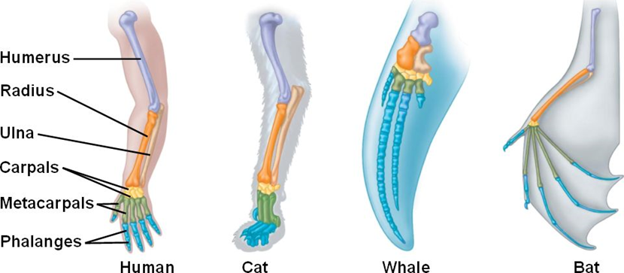
Similar bone structure suggests a common ancestor

Slide 7
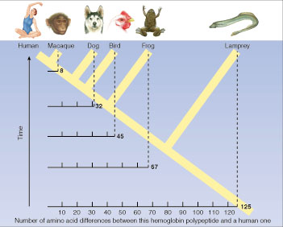
Similar gene sequences suggest a common ancestor

Slide 8
Fossil Evidence
Fossil evidence shows
The order in which species have existed through time
How species have changed over time
Fossilized organisms in more recent layers are more similar to present-day organisms, while fossils in older layers are less similar to present-day organisms

Slide 9
Fossil Evidence for Evolution
Nova: Fossil Evidence
Fossil evidence supports the theory that species have changed over time
SC.7.L.15.1
Notes:
Teachers: you should avoid the 5th example on the site as it gets into human evolution which can be controversial and is not part of the test item specs for FCAT

Slide 10
Natural Selection
PhET: Natural Selection
Natural selection – the species that is best suited to its environment will survive and reproduce (survival of the fittest)
Lots of genetic variation within a population increases the chances of a species survival
Sudden changes to the environment decrease the chances of a species survival
Species that cannot adapt to survive in the environment will become extinct
SC.7.L.15.2

Slide 11
Overview of Ecology
Biome - A biome is a large geographical region with plants and animals that are able to live in that location with its particular climate because they have adapted in different ways to the amounts of water, heat, and soil in that area. (tundra, grasslands, deserts, rainforests, deciduous forests, and marine environments)
Ecosystem - How the living things (biotic) interact with each other and interact with the nonliving things (abiotic) in a particular area is called an ecosystem.
Community - The living things in an ecosystem are called a community. The community consists of all the plants and animals that live and interact with each other in that ecosystem.
Population - A population is a group of the same kind of living thing in a community.

Slide 12
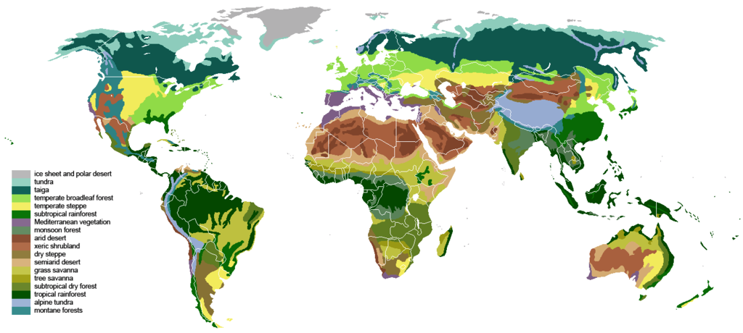
Biomes of the world

Slide 13
Energy flow through the ecosystem
The sun supplies the energy to the producers
Producers – organisms that make their own food
Primary Consumer – eats the producer
Secondary Consumer – eats the primary consumer
Decomposers get energy by breaking down dead organisms
In a food web, the arrows show the direction of the flow of energy

Slide 14
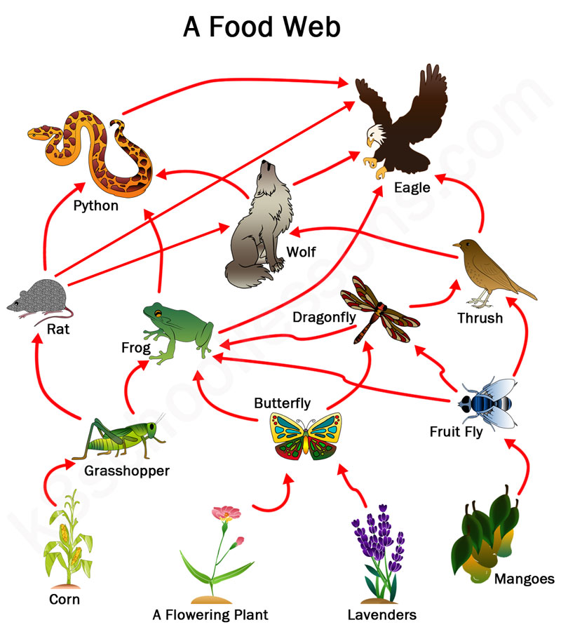
Food Web – arrow shows path of energy from lower to higher level

Slide 15
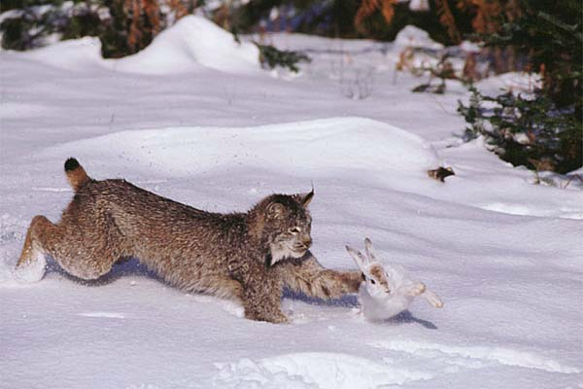
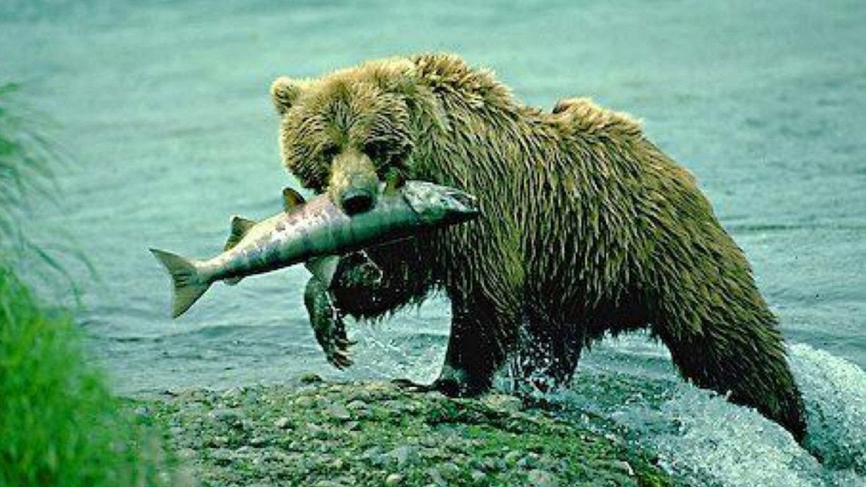
Relationships among organisms
Predation
The predator is the organism that eats the prey

Slide 16
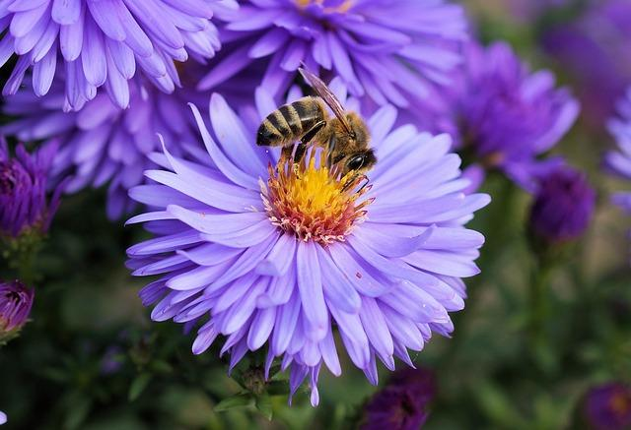
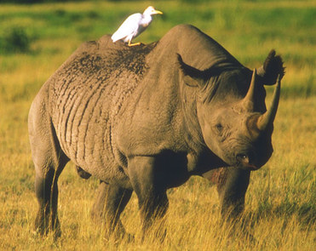
Symbiosis
Organisms form associations in which at least one organism benefits
Mutualism – both organisms benefit (bees and flowers)

Slide 17
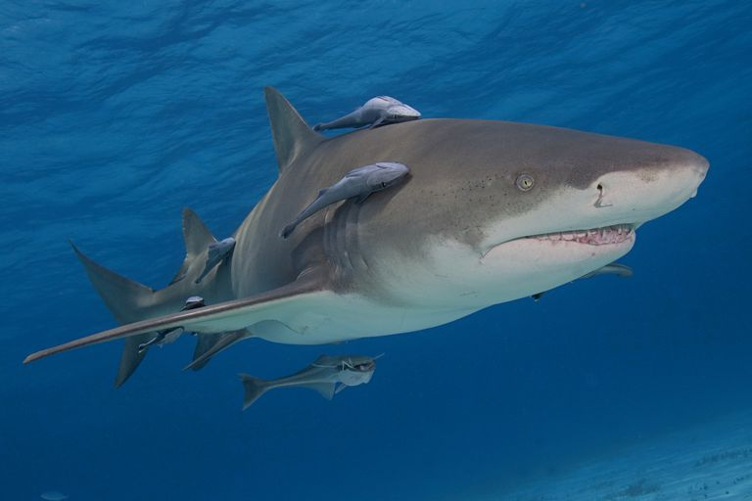
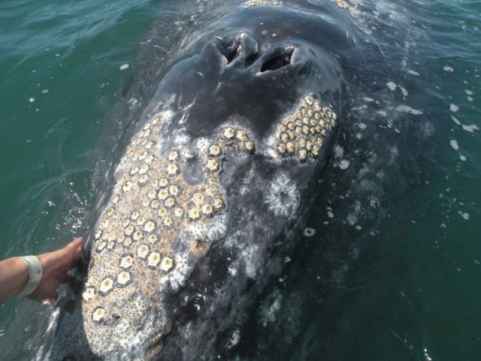
Commensalism – one organism benefits, the other is unaffected (barnacles and sea scallops)

Slide 18
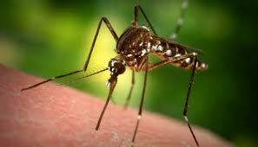
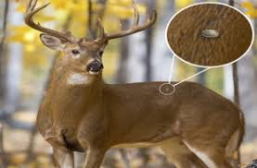
Parasitism – one organism benefits, while the other organism is harmed (dog and tick)
The organism that benefits is called the parasite
The organism that is harmed is called the host

Slide 19
Factors that limit populations
In a biological community, organisms compete for resources. Competition occurs when organisms fight for the same limited resource
In the natural world, limiting factors decrease plant and animal populations
availability of food
Availability of Water
shelter
Space
Mates
Predators
Disease

