Slide 1
FSSA 7th grade Life Science

Slide 2
Bell work 32-4
Explain how the reactions of photosynthesis and cellular respiration follow the Law of Conservation of Mass
Turn in Bell work today
Take out lab sheets
Log into computers – we will Kahoot Today!

Slide 3
Today’s Learning Goals
Bell work – turn in
Discuss Lab – turn in sheets
Finish 7th grade, pt 1 notes
Kahoot! Review

Slide 4
Cracking the Genetic Code
DNA – molecule that carries the genetic code in all organisms
Gene – a section of DNA that codes for a certain trait
Chromosomes – long stretches of coiled up DNA that carry multiple genes

Slide 5
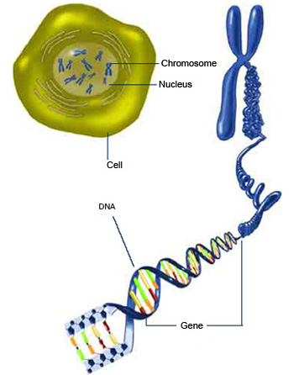
DNA
The diagram to the left shows the structural hierarchy of genetic material inside a cell including: nucleus, chromosome, gene, and DNA
A normal human has 23 pairs of chromosomes (one set of chromosomes comes from the mother and the other set comes from the father)

Slide 6
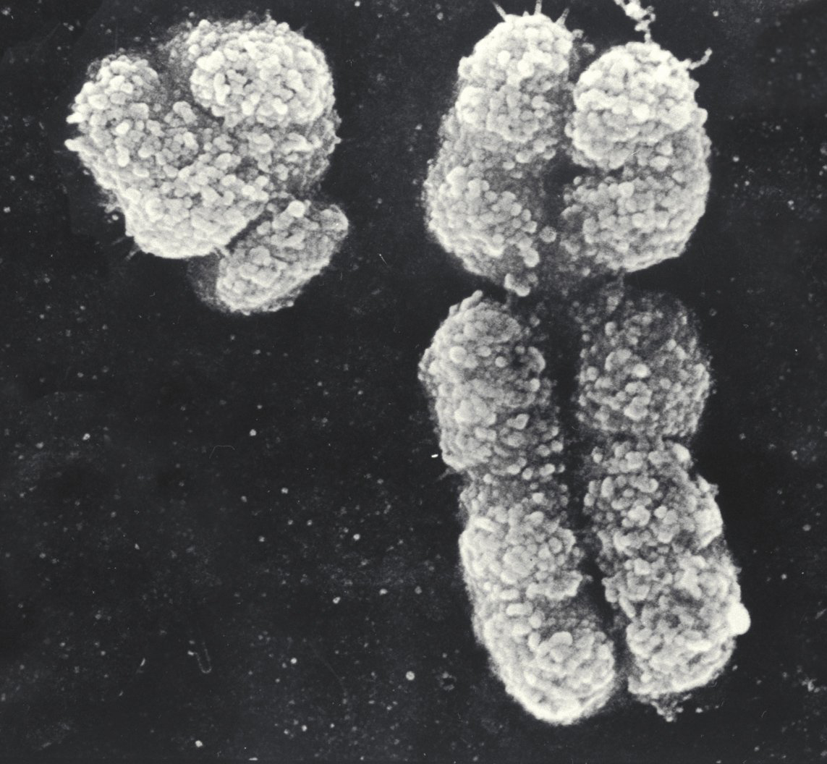
SEM Images of X and Y Chromosomes

Slide 7
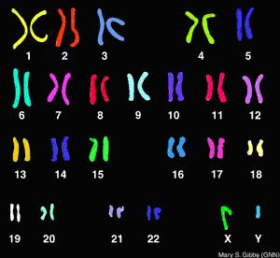
Human Karyotype

Slide 8
Reproduction
Sexual Reproduction – process of creating a new organism (offspring) that combines genetic material from two organisms (parents)
causes lots of variation in a species
Sperm and egg cells combine in fertilization

Slide 9
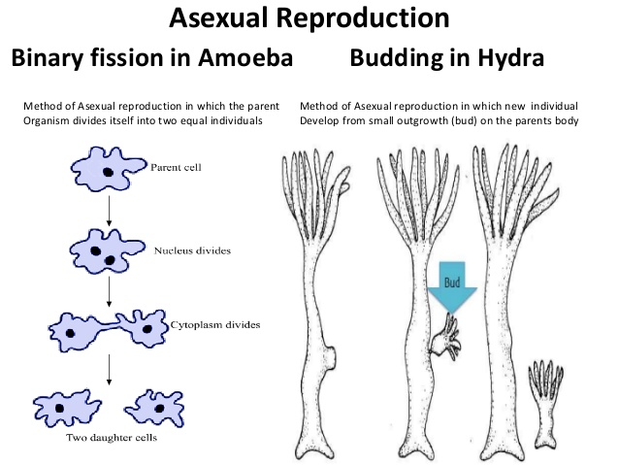
Asexual reproduction – process of creating a new organism that is the exact copy of parent
No variation
Parents and offspring are identical (same genes)

Slide 10
Heredity
Heredity – the passing down of traits from parents to offspring
Organisms have two sets of genes → one from mom and one from dad
Each gene in a gene pair is called an allele, can be dominant (T) or recessive (t)
The combination of genes is called genotype
Pure Genotypes: TT or tt
Hybrid Genotype: Tt

Slide 11
Punnett Squares
A Punnett square is a tool used to determine the chances of an offspring having certain traits
Genotype – gene combination (Tt, TT, tt)
Phenotype – physical expression of the genes (what it looks like/physical appearance)

Slide 12
Punnett Square Practice
Two homozygous dominant parents
Two homozygous recessive parents
Two heterozygous parents
A heterozygous and a homozygous dominant parent
A heterozygous and a homozygous dominant parent

Slide 13
Pedigrees
Pedigrees – a chart that shows the occurrence of a phenotype from one generation to the next
Circles represent females
Squares represent males
Horizontal lines show marriages
Vertical lines show offspring
Shapes shaded in are “affected” by the trait – could be dominant or recessive

Slide 14
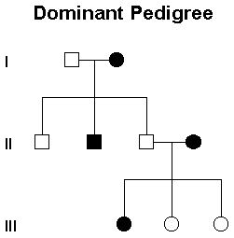
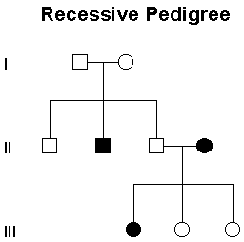

Slide 15
Mitosis
Process of cell division in which DNA copies one time and cell divides one time
Results in 2 Daughter cells, genetically IDENTICAL to parent and to each other
Same # of chromosomes as parent = diploid #
In humans, all body cells have 46 chromosomes
Used for:
Growth of an organism
Replacement of cells
Repair of damaged cells
Reproduction in ASEXUAL organisms only

Slide 16
Stages of Mitosis
Interphase – DNA copies
Prophase – 1st official stage, DNA condenses into chromosomes
Metaphase – chromosomes line up in middle of cell
Anaphase – copies of chromosomes pulled apart
Telophase – cytoplasm pinches in
Cytokinesis – 2 new cells
I Pray More At The Church

Slide 17
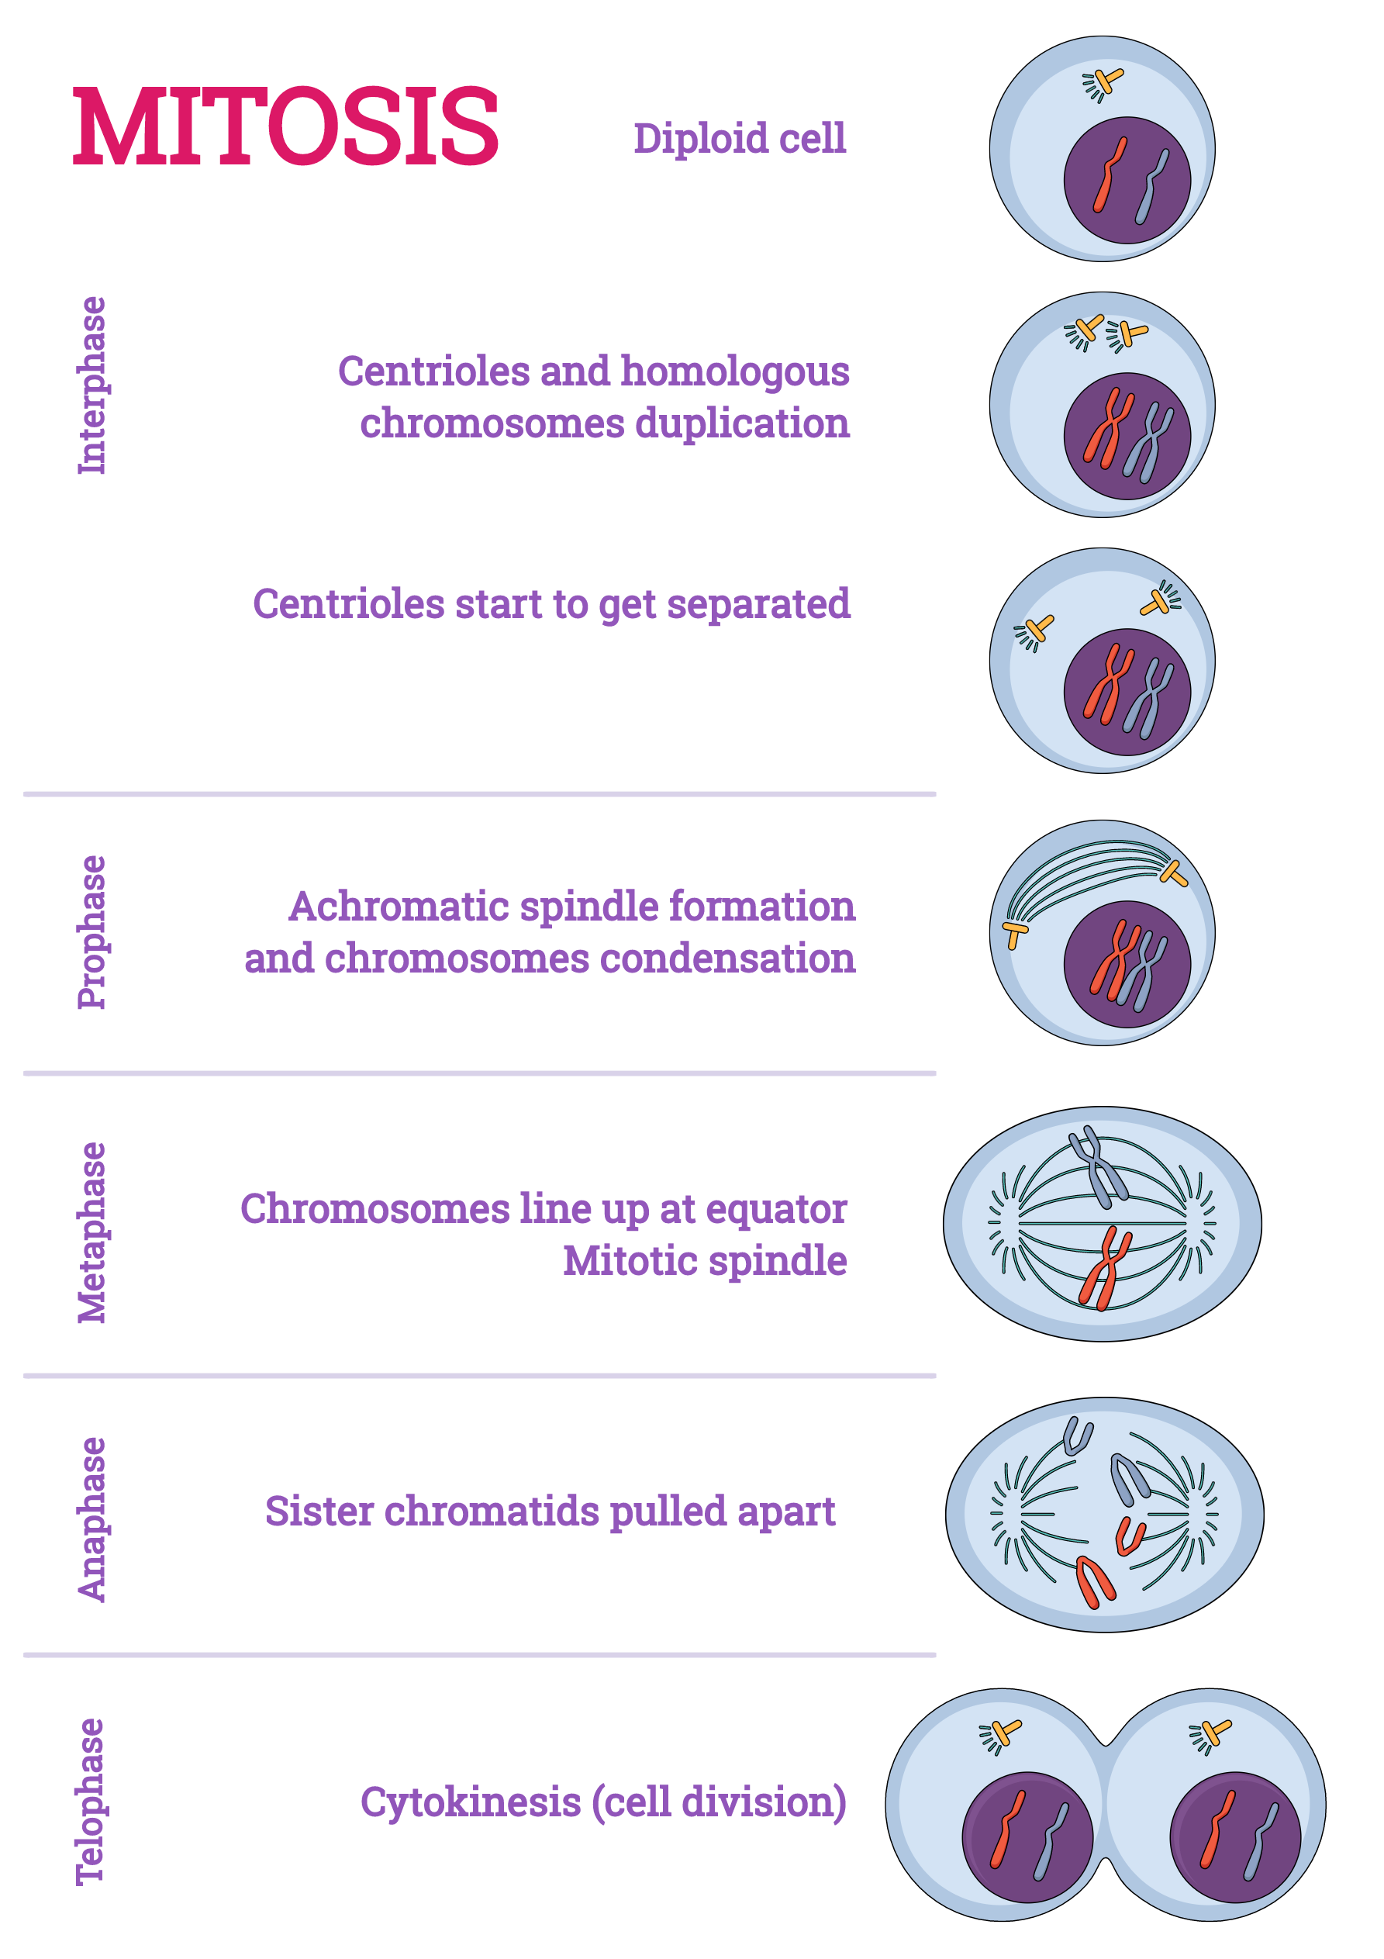

Slide 18
Meiosis
Process of cell division in which DNA copies one time and cell divides two times
Used for:
Making gametes (sperm and eggs)
4 daughter cells from one parent cell, have ½ the number of chromosomes as the parent
# of chromosomes = the haploid #

Slide 19
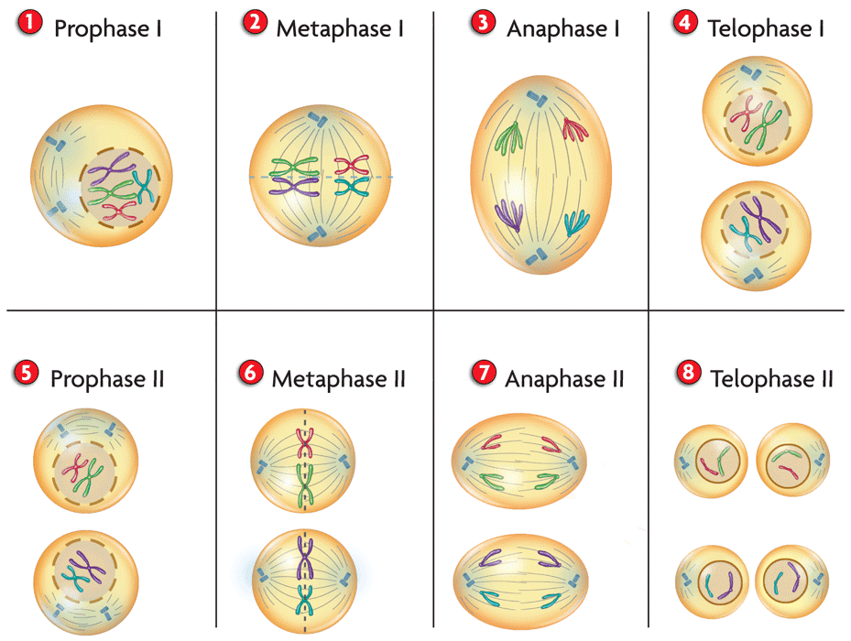

Slide 20
Mitosis and Meiosis
A
B
Which of the cells above went through mitosis and which went through meiosis? How do you know?
SC.7.L.16.3

