Slide 1
7th Grade Earth/Space Science FSSA REVIEW
Log into computers ASAP ☺

Slide 2
Bell work 30-5, turning in today!
Chemistry Riddle…. Who am I?
I have 26 protons, 26 electrons, and 30 neutrons
When you’re finished with bell work, log into your computer

Slide 3
Reminders for Skills USA Field Trip
Any final permission slips?
You must wear close toed shoes
If you’re bringing lunch, no drinks… disposable bag, rather than a lunch box, would be helpful – Write your name on it.

Slide 4
Study Guides are due Wednesday, not Tuesday

Slide 5
Minerals
Rocks are made up of minerals
Minerals are:
Naturally occurring
Crystalline Solid
Inorganic (non-living)
Definite chemical composition (represented by a chemical formula)

Slide 6
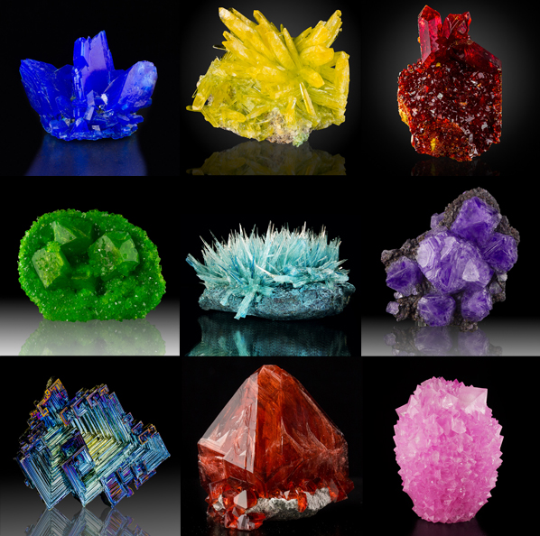

Slide 7
Minerals are identified by their properties
Hardness
Use Mohs scale to test, higher numbers scratch lower numbers
crystal shape (form)
Luster - shiny, dull, waxy, etc
color
Streak – powder left on streak plate
cleavage/fracture – smooth or rough edges
density (specific gravity)
special properties --reaction to acid --fluorescence --salty taste --magnetism

Slide 8
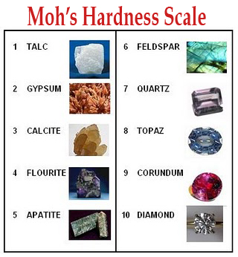

Slide 9
Three types of Rocks
Sedimentary – form when sediments are compacted and cemented together (lithification)
Sediment is created by weathering/erosion on Earth’s surface
Dissolved minerals cement the sediments together into a rock
Can contain organic materials such as shells, etc
Fossils found in sedimentary rock

Slide 10
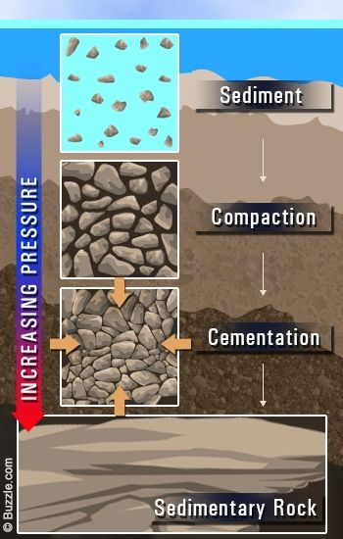
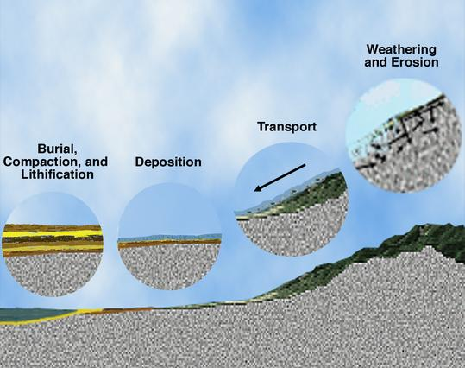
Formation of sediments and sedimentary rocks

Slide 11
Three types of Rocks
Igneous – form from cooled magma/lava
Magma forms inside Earth’s mantle
Rocks formed at Earth’s surface from lava are extrusive igneous (glassy, no visible crystals due to rapid cooling)
Rocks formed inside Earth from cooling magma are intrusive igneous (visible minerals – granite example)

Slide 12
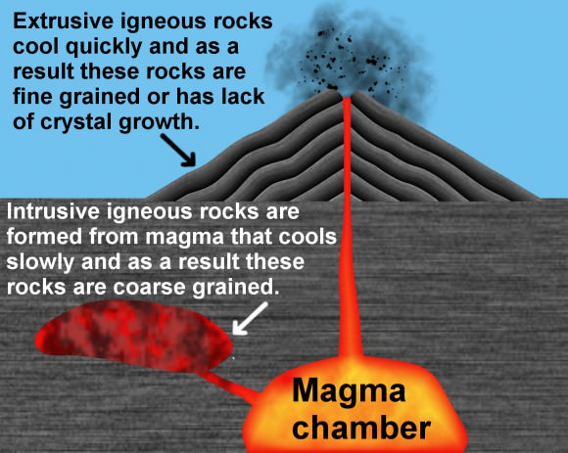

Slide 13
Three types of Rocks
Metamorphic – new rocks are formed when lots of heat and pressure “cook” old rocks
The pressure comes from the forces of tectonic plates pushing together
Foliated – have parallel layers
Non-foliated – not layered

Slide 15
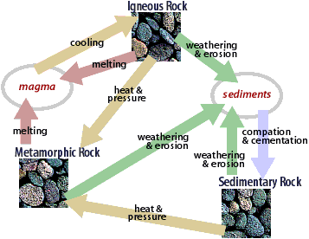
Animated Rock Cycle

Slide 16
Human impact
Humans negatively affect our planet in the following ways
Deforestation – removing roots causes more erosion
Burning fossil fuels - pollution
Oil spills
Interfering with animal habitats
Biodiversity is necessary for the success of the ecosystem
Urbanization – the building of cities

Slide 17
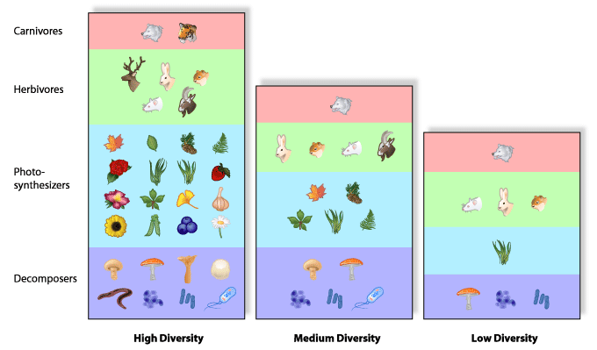
Bio = life Diversity = Variety

Slide 18
Measuring age of Earth
Relative age – only gives a comparison (older/younger)
Principle of superposition – the rock layers and fossils on the bottom are older than those on top
Anything that happens to a rock must have occurred after the rock already existed

Slide 19
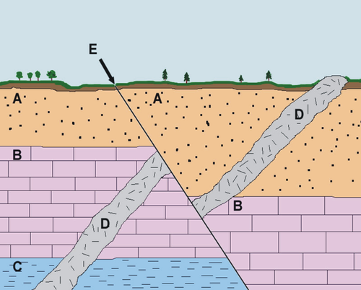

Slide 20
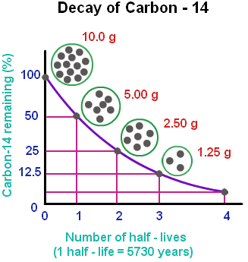
Absolute age – the age in years (450 years old)
Measured by radiometric dating
½ life - the amount of time it takes for half of a substance to change into another element by radioactive decay

Slide 21
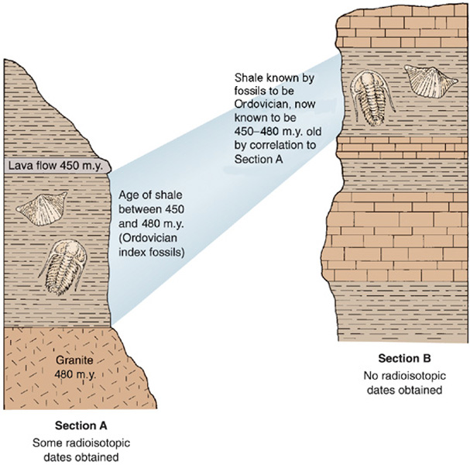
Correlation
Scientists determine the age of rocks by
comparing layers of rock in different areas
finding similar index fossils (trilobites)

Slide 22
Earth’s Layers
Inner core – solid, iron, densest layer
Outer core – liquid, iron (movement causes Earth’s magnetism)
Mantle – convecting liquid rock, movement causes tectonic plates to move
Crust – solid rock, outer layer, broken into pieces called tectonic plates
Oceanic crust is thinner and more dense than continental crust

Slide 23
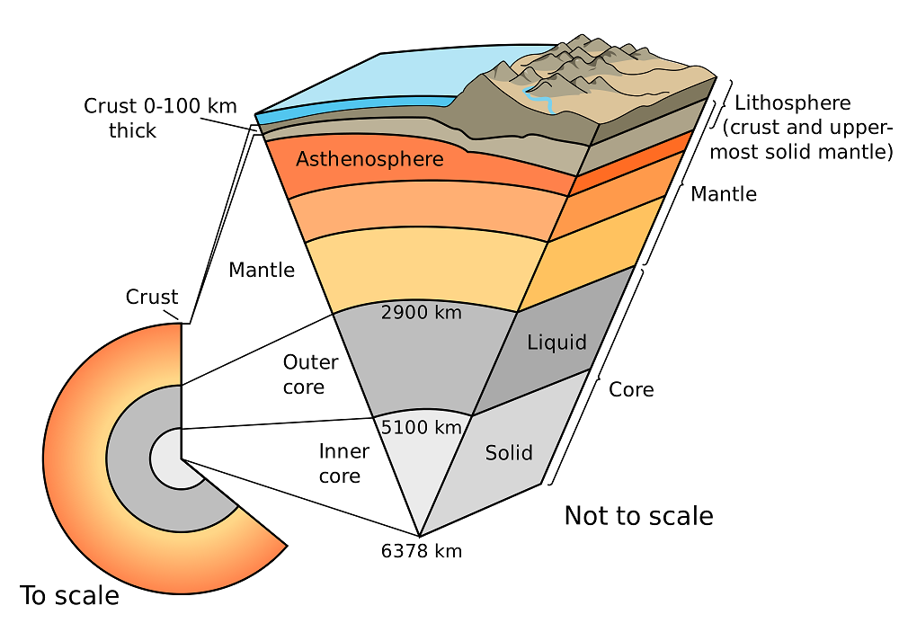

Slide 24
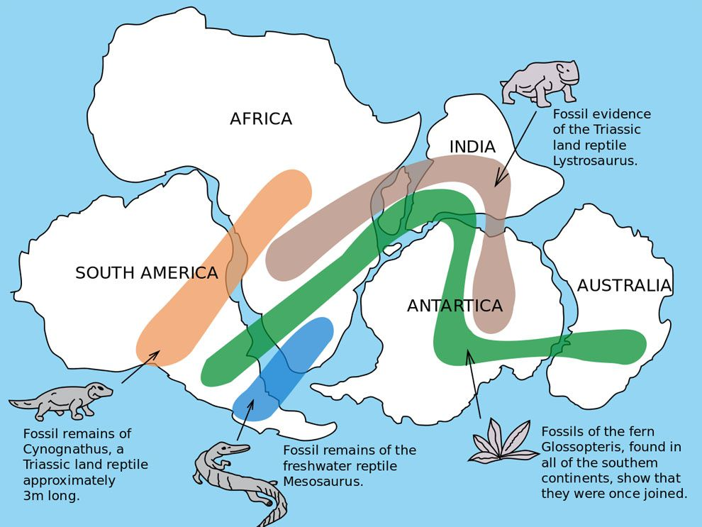
Continental Drift
Evidence for Wegener’s Theory of Continental Drift (separation of Pangaea)
Puzzle pieces
Climate change
Fossils
Similar Rock layers across continents
Problem…. He couldn’t explain how the continents moved
SC.7.E.6.5, SC.7.E.6.7

Slide 25
Theory of Plate Tectonics
60 years later after the concept of Continental Drift had been discarded…. Harry Hess discovered sea floor spreading
This was the evidence needed to revive the theory that land masses had moved over time!

Slide 26
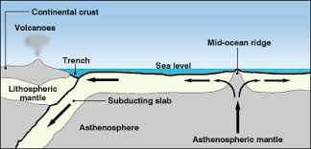

Slide 27
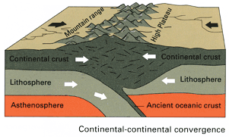
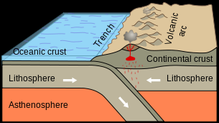
Tectonic Plate Movement
Convergent boundary – two plates move toward each other
2 continental plates = mountain building
1 oceanic, 1 continental = subduction zone → volcanoes and trenches

Slide 28
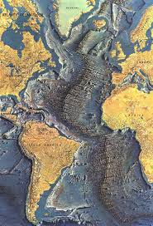
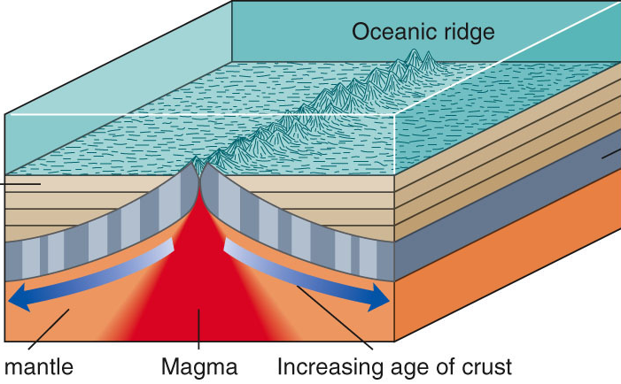
Divergent boundary – two plates move away from each other
2 oceanic plates – mid-ocean ridge, volcanoes

Slide 29
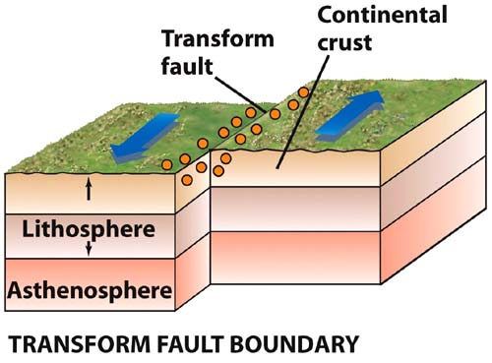
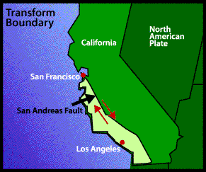
Transform boundary – two plates slide side-by-side
earthquake

Slide 30
