Slide 1
No Bell work question today
Log in to your computer and go to Kahoot! You need a pencil for taking notes. If you were absent Thursday, read Chapter 7, lesson 2

Slide 2
Potential Energy
Energy that is stored as a result of position
The higher up an object the greater its potential energy
The greater an object’s mass, the greater its potential energy

Slide 3
Kinetic Energy
The energy of motion
The greater the mass and speed of an object, the greater its kinetic energy

Slide 4
Transformation between Potential and Kinetic Energy
One form of energy can transform into another; however, some will always be “lost” from the system as thermal energy (friction)

Slide 5
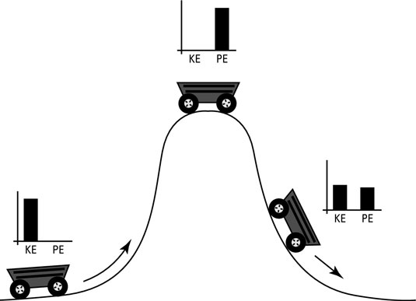
Illustration
At the highest point, object ahs all potential, 0 kinetic energy
At the lowest point, object has 0 potential, all kinetic
At all points in between, one is going up as the other is going down

Slide 6
Distance vs Time Graph
Distance goes on the y axis
Time goes on the x axis
Interpreting distance-time graphs
Straight line = constant speed
Curved line – speeding up or slowing down
Positive slope – object is moving forward
The steeper the slope, the faster the object is moving
Horizontal line – object stops
Negative slope – object is moving backward

Slide 7
How to calculate Speed
The speed of an object is equal to its distance divided by the time it takes to travel that distance
V = d/t

Slide 8
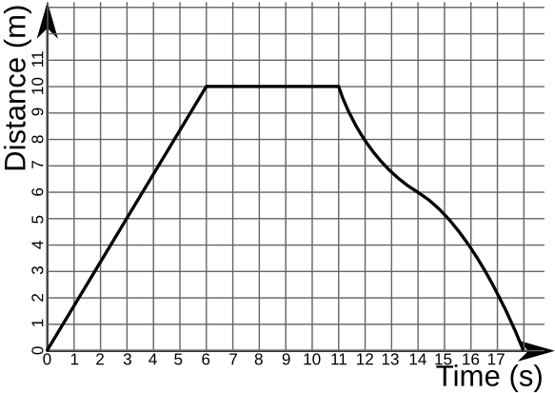
Distance vs Time
B
C
A
Describe the motion of the object during each section.
SC.6.P.12.1
Notes:
Technically benchmark is only for constant speed so C is not entirely appropriate, but it would be good to see if the students KNOW that C is not constant speed.

Slide 9
Types of forces
Contact forces – two or more objects are touching each other (even if you can’t see one or more of them)
Air resistance (works against the motion of object)
Push/pull
Friction (works against the motion of object)
Non-contact
Gravity
Magnetism
Electricity

Slide 10
Non-contact – these forces occur even when two objects are not touching
Non-contact
Gravity (you fall toward Earth when you jump out of a plane, even though you and Earth aren’t touching)
Magnetism (you feel the pull of a magnet against the refrigerator before the magnet and the refrigerator are touching)
Electricity (electrical force will occur from clouds to the ground, even though they are not touching)

Slide 11
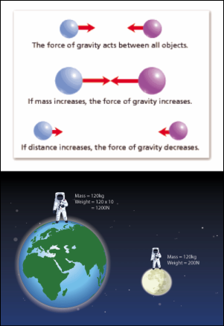
Distance, mass, and gravity
As distance between two objects increases, gravitational force (weight) decreases
indirect relationship
As mass of one or both objects increases, gravitational force (weight) increases
direct relationship

Slide 12
Balanced vs unbalanced forces
Net force = sum of all forces acting on an object
Steps to calculate net force
Add forces in direction of greater force
Subtract forces in other direction
Overall direction is that of the greater force
Balanced forces – net force = 0
Unbalanced force – net force does not = 0
A balanced force will cause the motion of an object to stay constant

Slide 13
Balanced forces – net force = 0
Unbalanced force – net force does not = 0
A balanced force will cause the motion of an object to stay constant
Newton’s 1st Law of Inertia states that – “An object in motion will stay in motion (straight line and constant speed) and an object at rest will stay at rest unless an UNBALANCED FORCE ACTS UPON IT.”

Slide 15
Unbalanced forces
An unbalanced force will cause an object to accelerate
Acceleration includes:
speeding up
slowing down
changing directions

Slide 16
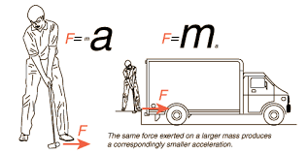
Newton’s 2nd and 3rd laws of motion
Newton’s 2nd law states that Force is equal to mass times acceleration F = ma

Slide 17
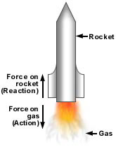
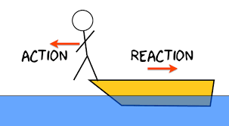
Newton’s 3rd law states that every action force has an equal and opposite reaction

