Slide 1
6th Grade Life Science Review
Organization of Organisms

Slide 2
Structure of an organism
Unicellular – organisms that exist as a single cell
Bacteria, most protists, some fungi
Multicellular – organisms made of more than one cell
All plants and animals
Most fungi
Many algae

Slide 3
Hierarchy of a multicellular organism
Organisms are made up of multiple organ systems
An organ system is made up of multiple organs
An organ is made up of multiple tissues
A tissue is made up of multiple cells
A cell is made up of multiple molecules – smallest unit of life
Cells contain organelles, which are made of molecules
Molecules are made up of atoms
The atom is the smallest unit of all matter

Slide 4
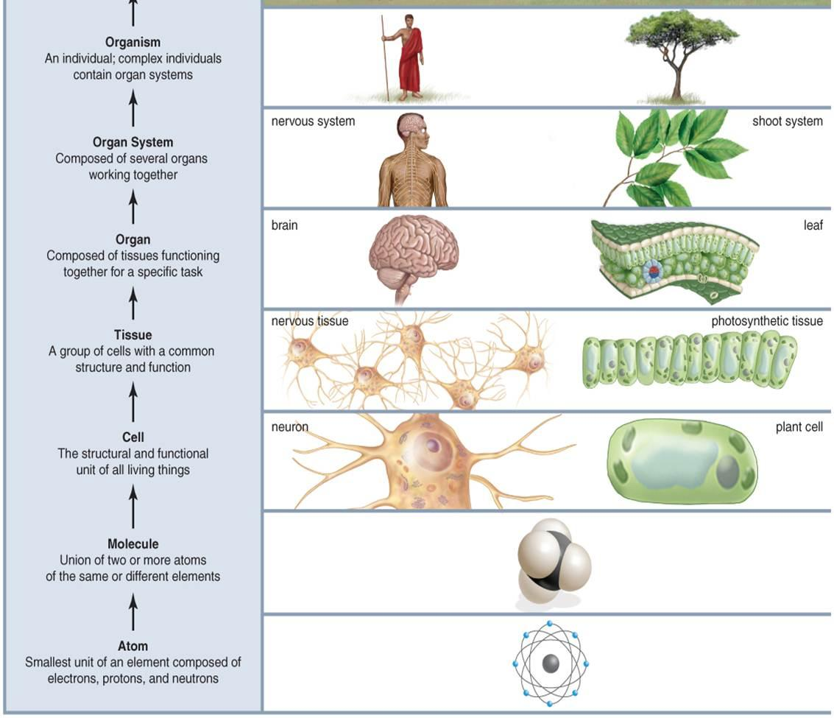
Hierarchy of a multicellular organism

Slide 5
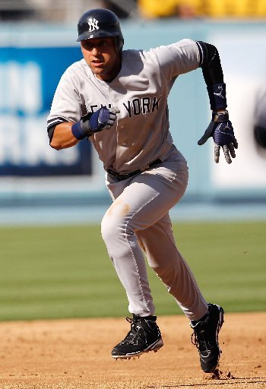
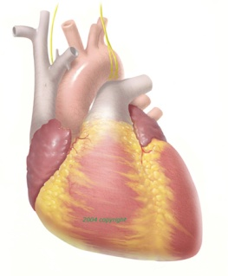
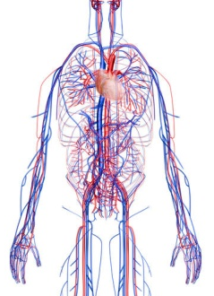
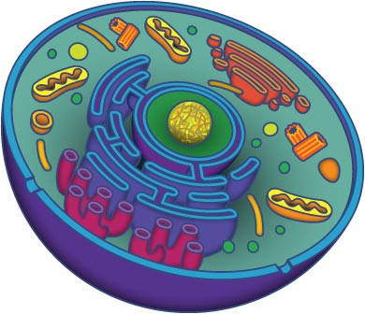
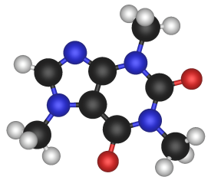
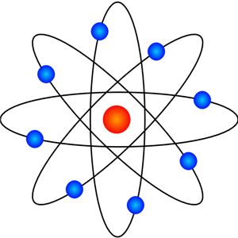
Hierarchy
A
B
C
D
E
F
G
Label the pictures above as: atom, molecule, cell, tissue, organ, organ system, or organism. Then put them in order of increasing complexity.

Slide 6
Cell Theory – an EXPLANATION
All living things are made out of cells
Cells are the smallest unit of life
All cells come from other cells
Like many other examples throughout Science, the Cell theory was developed and modified over time by many scientists (Hooke, Schwann, and Schleiden get most of the credit)
SC.6.L.14.2

Slide 7
Homeostasis
Homeostasis – processes cells use to maintain their internal and external environments
All living organisms try to maintain homeostasis
All ecosystems try to maintain homeostasis
Processes that maintain homeostasis
Getting Energy from food
Getting rid of waste
Reproduction

Slide 8
Organelles
Plant AND animal cell organelles:
Nucleus – contains the DNA, directs activity of cell (city hall)
Cell Membrane – maintains homeostasis (city limits)
Mitochondria – produce energy by respiration (power plant)
Cytoplasm – gel-like substance enclosed within cell membrane
Ribosomes – make proteins
Golgi bodies – Packages, sorts, and delivers proteins (post office)
Endoplasmic Reticulum (rough with ribosomes/smooth without) – transports proteins and other items around the cell (highway system)

Slide 9
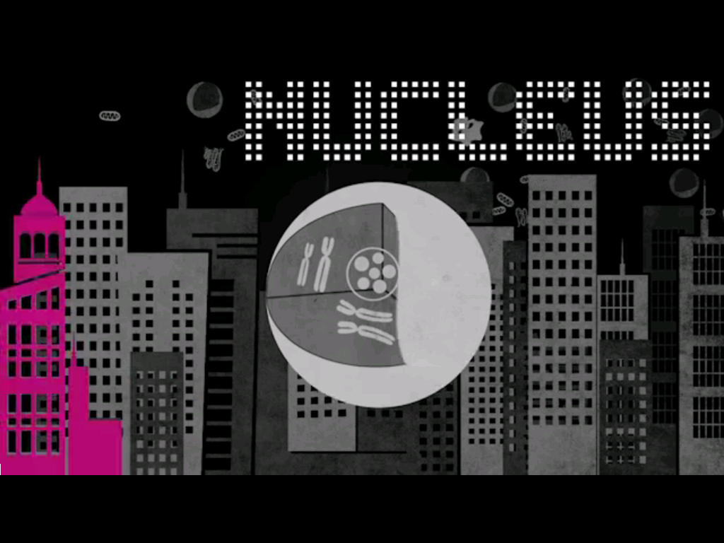
Cell City Music Video

Slide 10
Plant organelles
In addition to the organelles found in animal cells, plant cells also include the following organelles
Chloroplasts – location of photosynthesis, where plants and other autotrophs make their own food
Cell Wall – structure and protection of cell (outside the cell membrane)
Permanent vacuole – large storage site, takes up approx. 90% of cell

Slide 11
Bacteria are so Basic
No nucleus, DNA scattered throughout cell
Cell wall present
Unicellular (exist as one cell)

Slide 12
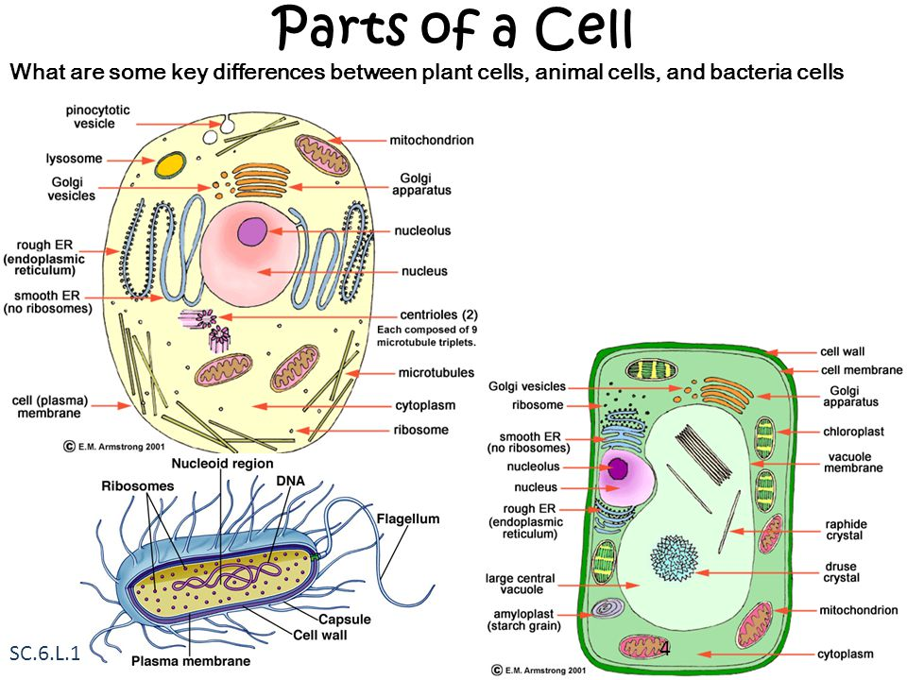

Slide 13
Cell Structure and Function
The structure of a cell helps it do it’s job (perform it’s function)
Muscle cells have lots of mitochondria for energy
Cell wall and vacuole make plant cells rigid
A bacterial cell’s flagellum helps it move
Red blood cells have no nucleus – allow more oxygen transport

Slide 14
Human Body Systems
Digestive – intake and metabolism of food
Nervous – sends messages through electrical signals
Reproductive – produce offspring
Integumentary – protective layer
Muscular – provides movement
Skeletal – provides structure
Endocrine – makes hormones and other chemicals
Lymphatic/Immune – fights infection
Circulatory – transports materials through the body
Excretory – eliminates waste
Systems work together to maintain homeostasis (balance) in the body

Slide 15
Infectious agents
Bacteria – Prokaryotic, Single cell, Living organisms
not all bacteria are harmful
Viruses – Not living organisms, viruses use the DNA or RNA of a host to replicate (make new viruses)
Fungus – eukaryotic, single or multicellular, no chlorophyll
include mushrooms, yeasts, etc

Slide 16
Classification of organisms
Domains: archaea, bacteria, eukarya
Kingdoms: Plants, Animals, fungi, protists (all in kingdom eukarya)
Phylum
Class
Order
Family
Genus
Species
How to remember: Dear King Phillip Came over for Great Spaghetti!
Organisms are identified by their Genus and Species Names
Example: Canis familiaris

Slide 17
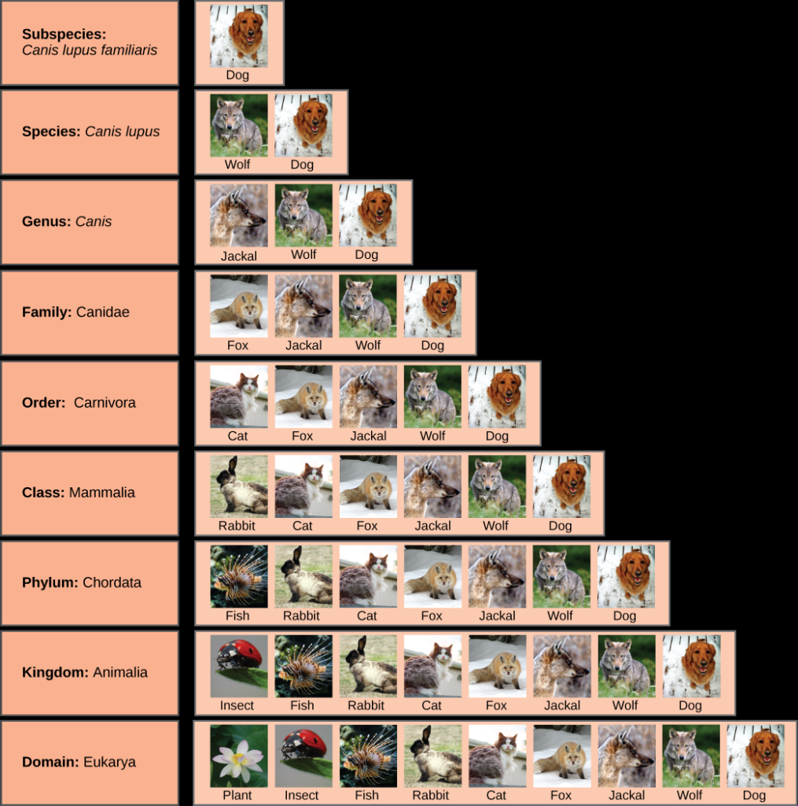

Slide 18
Other ways of classifying organisms
How it obtains energy:
Autotrophs produce their own food (plants and bacteria), AKA producers
Heterotrophs have to obtain their food from an outside source, AKA consumers
Cell Structure:
Prokaryotes – no nucleus and Eukaryotes – have a nucleus
Similar organism structures
Vertebrates and invertebrates
Vascular and nonvascular plants

