Slide 1
Bell Work 23-5 (turn in next week)
At room temperature, the solubility of sugar is approximately 2g/mL of water. Based on this intrinsic property of matter, how much sugar would you expect to be able to dissolve in 100mL of water?
Log into computers
Flight Adventure Deck assignment?

Slide 2
FSSA Folders
On your folder tab, write clearly….
Last Name, First Name - Period

Slide 3
Back to the drawing board….
You will complete notes each week and add to your folder. When we’re finished with FSSA review, your folder will count as a test grade!

Slide 4
Changes on Earth’s Surface
Weathering – rocks are broken down by water, wind, movement of animals
Erosion – transportation of rock fragments, grains, etc. Movement from one place to another
as rocks are moved they become smoother and sorted by size
In a riverbed, the rocks upstream are rougher and more varied in size while the rocks downstream are smoother and more uniform in size
Deposition – rock fragments are deposited or “dropped off” in a new location

Slide 5
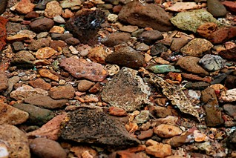
How erosion shapes rocks in a riverbed
River rock upstream is larger and more jagged
River rock downstream is smaller and smoother

Slide 6
Landforms in FL
Dune – pile of windblown sand, vegetation prevents erosion
Delta – deposit of sand/sediment where stream enters larger body of water
Sinkhole – hole or depression in ground, in FL because limestone dissolves
Mangroves – forests of trees that grown in saltwater
Aquifer – layer of underground water-bearing rock
Wetlands/Everglades – land saturated with water, rich in biodiversity

Slide 7
Heat Transfer on Earth
Conduction – ground heats atmosphere near ground because they are touching
Convection – Warm air rises, cool air sinks
Radiation – EM waves from the sun travel through space
The Sun is the source of energy responsible for all these processes

Slide 9
Earth’s Spheres
Geosphere – land
Hydrosphere – water
Cryosphere – ice
Atmosphere – air
Biosphere – living organisms

Slide 11
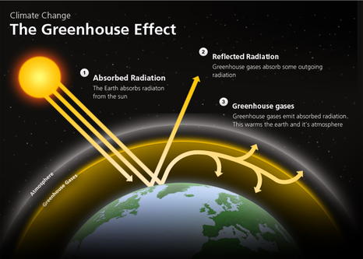
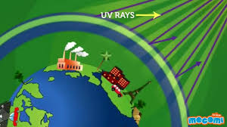
Earth’s atmosphere serves as a “shield” that protects us from harmful debris, energy, etc and it insulates the planet by trapping heat in a process called the Greenhouse Effect

Slide 12
Layers of Earth’s atmosphere
Troposphere – closest to land, where weather occurs
Stratosphere – ozone is here
Mesosphere – middle layer, very cold
Thermosphere – temp changes
Exosphere – outermost layer – some molecules escape into space

Slide 13
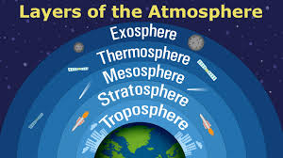
The Smart Man Takes the Elevator

Slide 14
Wind Patterns
Wind occurs because Earth is heated unevenly
Land heats and cools faster than water, hot air rises and cool air sinks through convection
Sea breeze happens in the morning, when air over land heats quickly and wind blows from the sea
Land breeze happens in the evening, when air over land cools quickly and wind blows from the land back out toward the sea

Slide 15
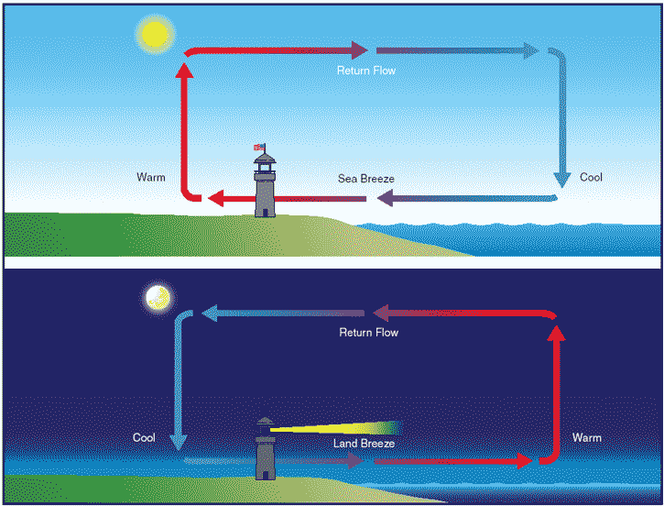
Local Winds
SC.6.E.7.5

Slide 16
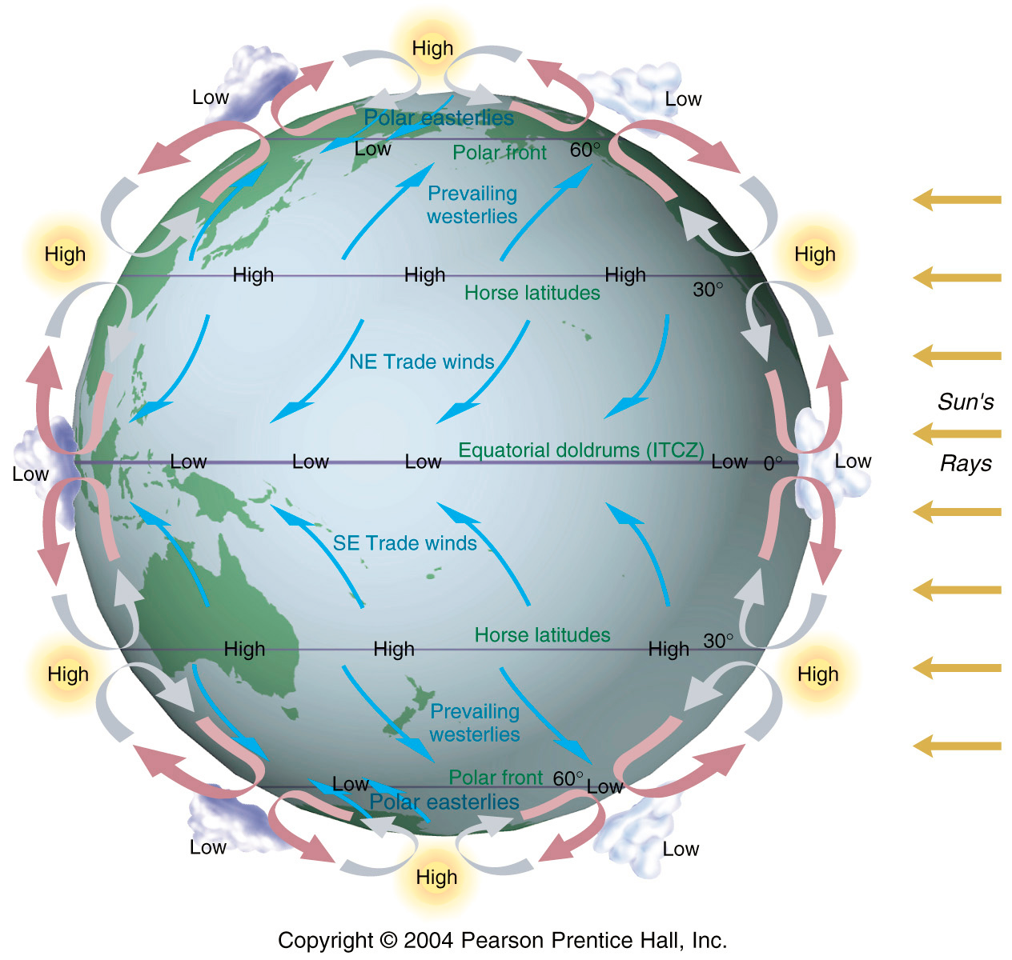
Global Winds

Slide 17
Weather vs. climate
Weather is the day-to-day state of the atmosphere in a region
Short term conditions
Climate is how the atmosphere behaves over a long period of time (60 years +)

Slide 18
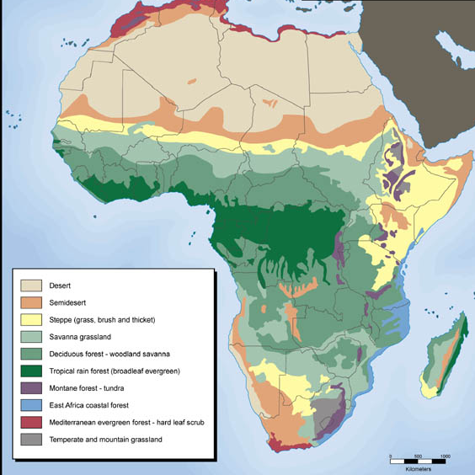
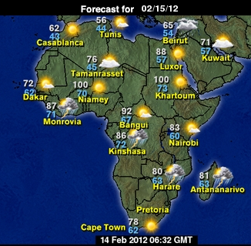
Weather vs Climate
Which map above shows Weather and which shows Climate? Explain your choice.
SC.6.E.7.6

Slide 19
The effect of the Water Cycle on Weather and Climate
The cycling of water between the hydrosphere and the atmosphere effects weather and climate patterns
When a warm front and a cold front meet, the warm wet air rises – causing rain
Large bodies of water help moderate the temperature of nearby land
Sudden or extreme temperature changes rarely take place on land near large bodies of water

Slide 20
The Effect of Ocean Currents on Weather and Climate
Water near the equator carries energy from the sun to other parts of the ocean
Warm ocean water affects local temperatures and humidity, fuels hurricanes
Ocean currents regulate global temperatures – cold currents cool the air in coastal areas, while
warm currents warm the air in coastal areas

Slide 21
The Effect of Jet Stream on Weather and Climate
Jet streams are long-distance winds that travel above local winds for thousands of km
A polar jet stream pulls cold air down from Canada into the U.S. and pulls warm air up toward Canada
Strong storms tend to form along jet streams

Slide 23
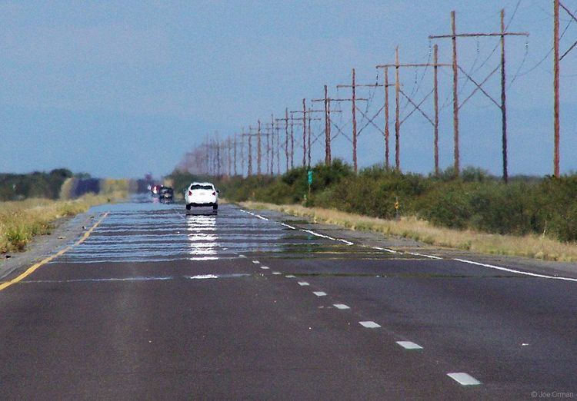
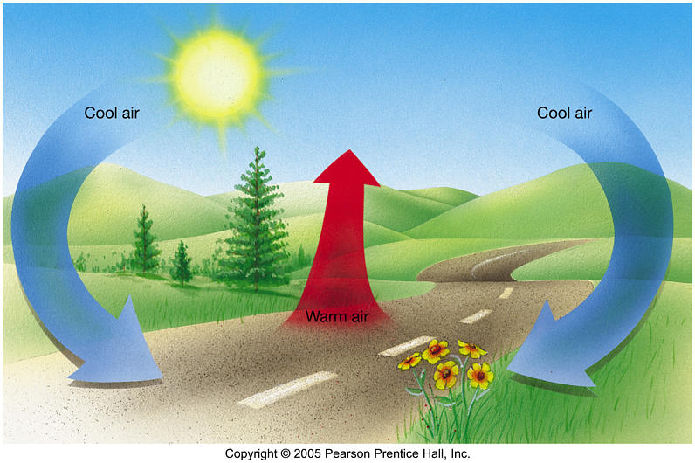
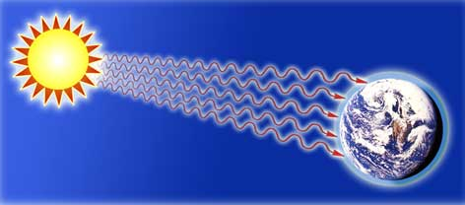
Radiation, Conduction, Convection
Heating of air over the road
causing a mirage
Hot air rises, cold air sinks
Sun’s heat
travels through space
Which type of heat transfer does each image represent?
SC.6.E.7.1

Slide 24
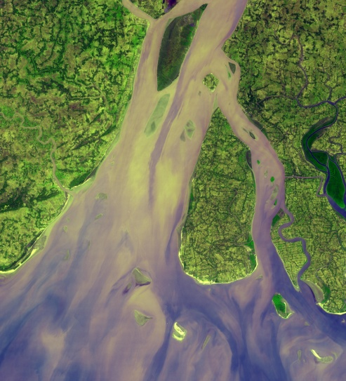
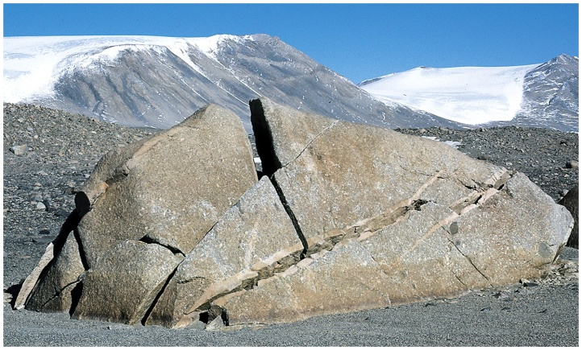
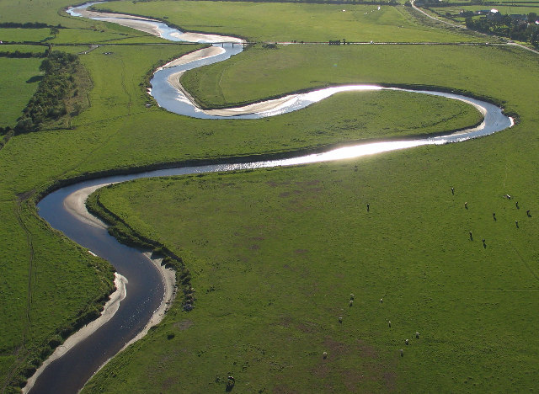
Weathering, Erosion, Deposition
Cracked Rock after Expansion
River Delta
Meandering Stream
Explain how water is changing the landscape in each image above. Be sure to indicate whether the image shows weathering, erosion, or deposition
SC.6.E.6.1

Slide 25
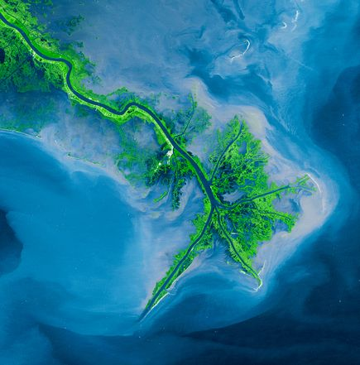
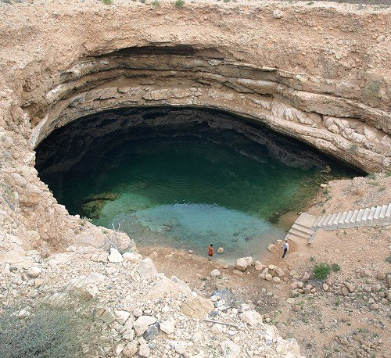
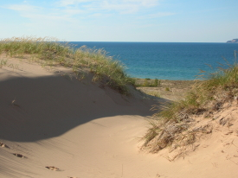
Landforms
Label the images above as either a dune, delta, or sinkhole. Which of these features can be found in Florida?
SC.6.E.6.2

Slide 26
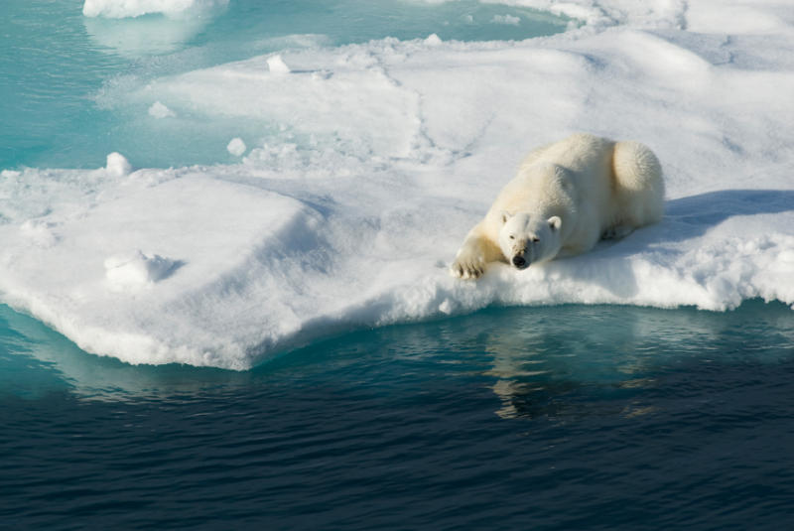
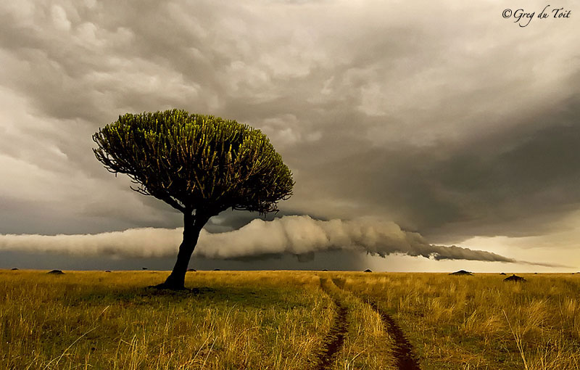
Spheres
Geosphere
Hydrosphere
Atmosphere
Biosphere
Cryosphere
Identify what spheres are shown in each of the pictures above?
SC.6.E.7.4

