Slide 2
Bell Work 27-4
Describe the physical properties of your jelly bean
Take your jelly bean and rest it on your tongue…. Do not chew it!
Describe the flavor of the jelly bean’s outer coating
Move the jelly bean around inside your mouth until the outer coating has completely dissolved. This may take a few minutes.
Describe how the flavor changed once the outer coating was gone.

Slide 3
Acids
An acid is any compound that produces/donates protons (H⁺) in water
The greater the concentration of hydrogen ions produced, the stronger the acid
Sulfuric acid H₂SO₄
Vinegar CH₃COOH

Slide 4
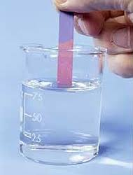
Properties of acids
Taste sour
Turn blue litmus paper red
React with bases to produce salts, which are neutral

Slide 5
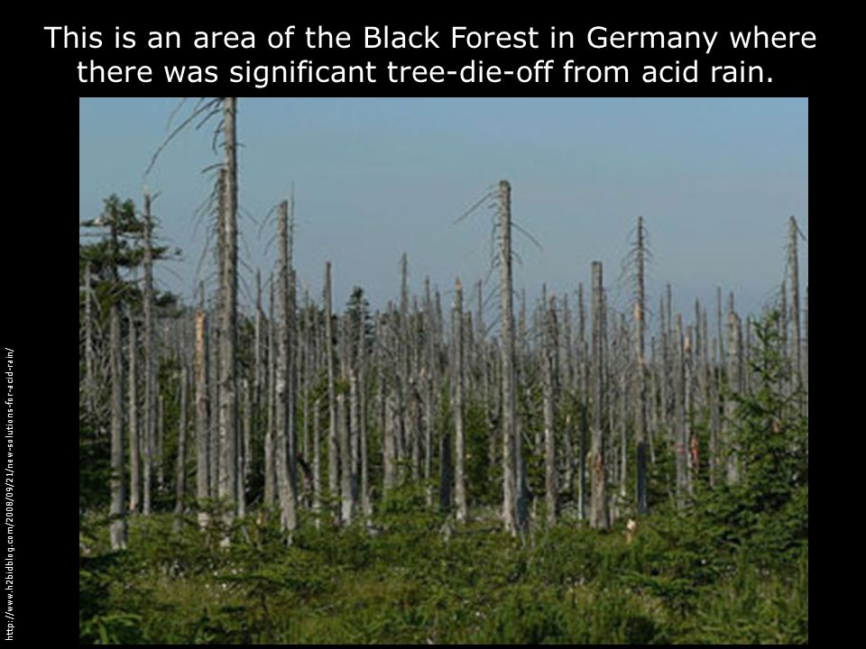
Real World Examples
Acid rain
Ocean Acidification - NBC Learn

Slide 7
Bases
A base is any compound that accepts a proton in water
The greater the concentration of hydroxide [OH] ions produced, the stronger the base
Sodium Hydroxide – NaOH
Ammonia – NH₃
Baking Soda – NaHCO₃

Slide 8
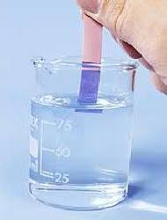
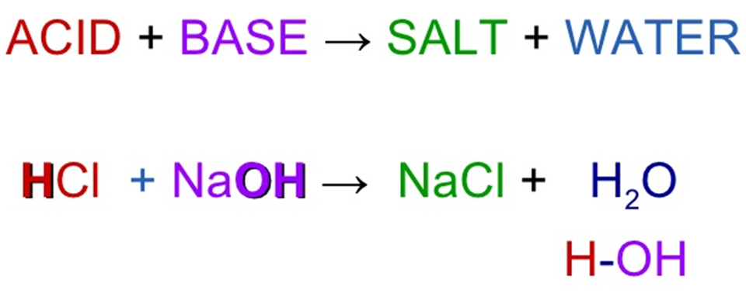
Properties of Bases
Taste Bitter
Change red litmus paper blue
Feel slippery
React with acids to form salts, which are neutral

Slide 9
Dirt on Ammonia – NBC Learn

Slide 10
pH Scale
The pH scale measures the hydrogen concentration in a solution
The pH scale goes from 0 to 14
A solution of pH less than 7 is considered acidic
The lower the pH the stronger the acid
A solution with pH higher than 7 is considered alkaline (a base)
The higher the pH, the stronger the base
A solution with a pH of 7 is considered neutral

Slide 11
White Board Check
Answer Acid, Base, or Neutral

Slide 12
Acid, Base, or Neutral

Slide 13
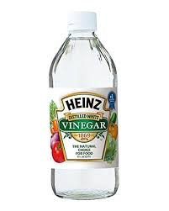
Acid, Base, or Neutral

Slide 14
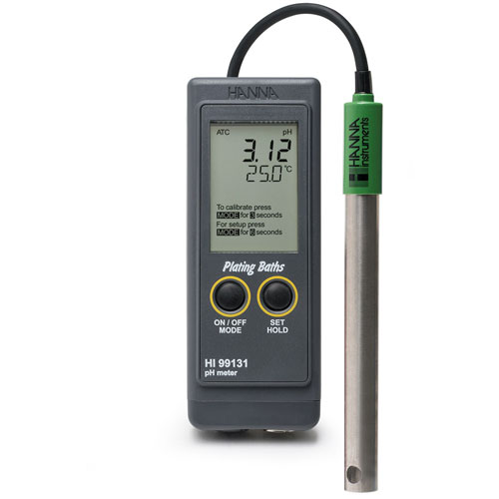
Acid, Base, or Neutral?

Slide 15
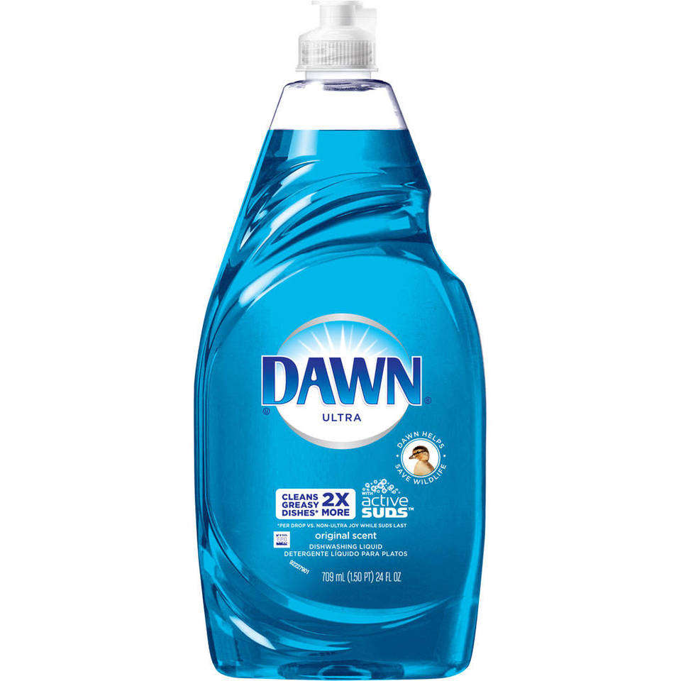
Acid, Base, or Neutral

Slide 16
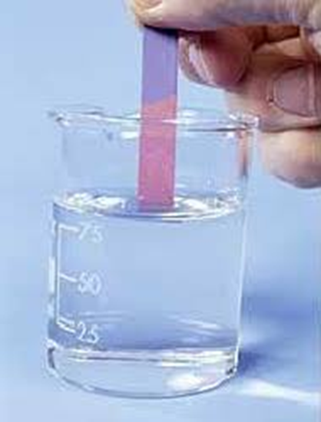
Acid, Base, or Neutral

Slide 17
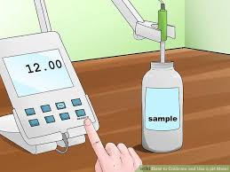
Acid, Base, or Neutral

Slide 18
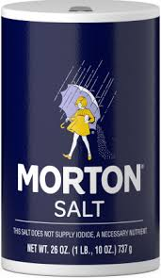
Acid, Base, or Neutral

Slide 19
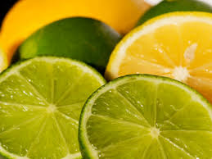
Acid, Base, or Neutral

Slide 20
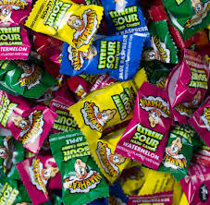
Acid, Base, or Neutral?

